Slide 1
IT 705 PROJECT MANAGEMENT
WELCOME!

Slide 3
2021 Digital AI State of Agile Survey
This year’s findings indicate significant growth in Agile adoption within software development teams, increasing from 37% in 2020 to 86% in 2021.

Slide 4
Waterfall
AGILE

Slide 5

About Me…
Advise companies on how they can improve their operations through agile
Worked in the following industries:
Insurance
Investment
Social Services
Published a book about improving agile performance – Test Requirement Driven Development (TREDD)
Spend most of my time as a Management Consultant, helping people find their own pathways towards greater professional fulfillment
Education
Manufacturing
eCommerce

Slide 6
YOUR HEALTH & COVID-19
I have outlined a number of details regarding COVID-19 and your requirements of this course.
Please keep in mind, that I value your health as paramount to this course.
If at anytime you are concerned about attendance, participation, or completion of this course due to your health or the health of your family members, please don't hesitate to contact me immediately so we can make arrangements that best meets your personal health needs.
If necessary we can confer with additional UNH staff members to discuss what would work out best for your needs.

Slide 7
GRADES
Course Area | Percentage
Attendance and Participation | 10
Assignments/Quizzes | 20
Midterm | 30
Final | 40

Slide 8
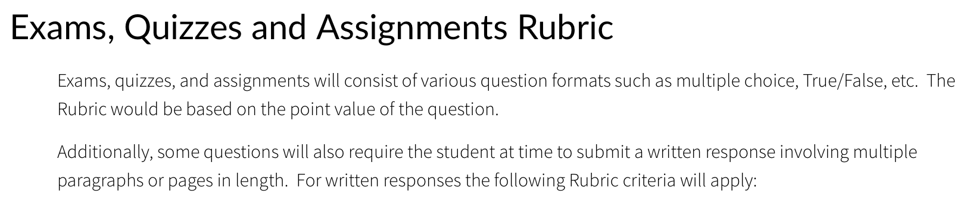

Slide 9
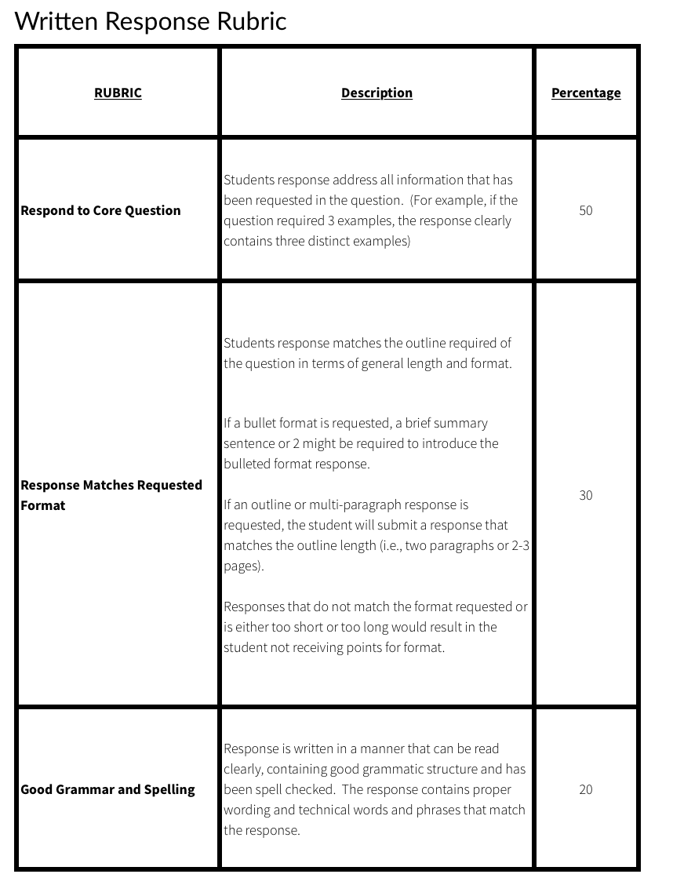

Slide 10
Policy on Late Submissions
Any assignments, quizzes, projects, or exams submitted late will result in 33 percent penalty of total possible score.
Absentee Policy
Since each course involves intense learning through exercises during class as well as participation in class, attendance is expected for each student for each class. The exception would be for school recognized circumstances.
Attendance will be taken each class and will count toward the final grade.
We do have class on the Monday of Thanksgiving week. Be prepared to be in class that day. No exceptions will be accepted other than school recognized circumstances.
Class Participation
Due to the highly interactive nature of the course each week, Weekly participation is required in the classroom.
This means active participation in class room discussions and active contribution to team bases class exercise. Failure to participate in class may result in a reduction of non attendance for that class.
Inclement Weather Policy
Should we face a situation where classes at UNH are cancelled due to inclement weather, there could be a possibility that class scheduled on that day would be held via ZOOM video conference. If that does happen, you will be notified within 1 hour before the schedule starting time for that class.
Instructor’s Office Hours
I am available to discuss and topics or support that may be needed from the course immediately after each class. Other times may be scheduled Tuesdays - 5:30-7pm; Fridays 4:30-5:30 PM, upon request via email to: Michael.O’Reilly@unh.edu

Slide 11
Syllabus
VIEW IN CANVAS

Slide 12
TEXT BOOKS & Lego’s
All text books are available online, through UNH.
Additionally there will be YouTube videos and podcasts which you will need to access for assignments and course material. Those will be provided.
You will be required to purchase a Lego Serious Play kit for class on November 22. They are available in the bookstore for <$7. You must come to class with the bag unopened.

Slide 13
TEAM NORMS
A key element of organizations who have achieved success through agility are the abilities for teams to perform.
One of the struggles organizations face are teams and management understanding how to work together in their domain.
TEAM NORMS are agreements that clarify expectations and accountabilities.
Let’s take a few minutes and see if we can create TEAM NORMS for this class.
https://app.mural.co/t/bip9946/m/bip9946/1599531206799/83110e5075c7bae2e475eec18ab758af26acb40e

Slide 14
CROWD WISDOM
Answer This Question:
What do you you feel will be the most important technology in 5 years from now?
Walk around randomly swapping index cards
When I say STOP, pair up with someone who you haven’t paired up with before
Introduce yourselves
Say where you grew up, and where you are living this semester
Read the card you are holding to you partner and say something about if you agree or disagree with it.
Your Partner do the same for the card you are holding
Then on the BACK of the index card rate what the card says – 1 = HORRIBLE -> 5 = This is the best idea ever!

